Slide 1
Chapter No:9
Counters

Slide 2
TOPICS
1. Asynchronous Counters
2. Synchronous Counters
3. Cascaded Counters
4. Counter Decoding

Slide 3
Counters are classified into two broad categories according to the way they are clocked: asynchronous and synchronous.
In asynchronous counters, commonly called ripple counters, the first flip-flop is clocked by the external clock pulse and then each successive flip-flop is clocked by the output of the preceding flip-flop.
In synchronous counters, the clock input is connected to all of the flip-flops so that they are clocked simultaneously.

Slide 4
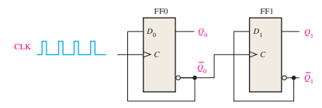
Asynchronous Counters
An asynchronous counter is one in which the flip-flops (FF) within the counter do not change states at exactly the same time because they do not have a common clock pulse.
A 2-Bit Asynchronous Binary Counter

Slide 5
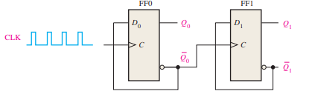
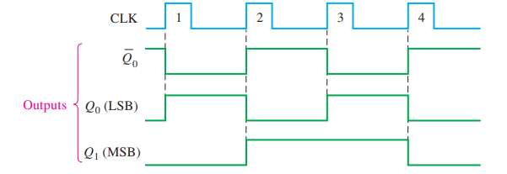
Asynchronous Counters
Both flip-flops are connected for toggle operation (D = Q) and are assumed to be initially RESET (Q LOW).
The positive-going edge of CLK1 (clock pulse 1) causes the Q0 output of FF0 to go HIGH.

Slide 6
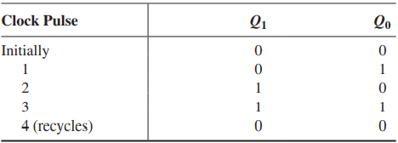
Asynchronous Counters
The term recycle is commonly applied to counter operation; it refers to the transition of the counter from its final state back to its original state.

Slide 7
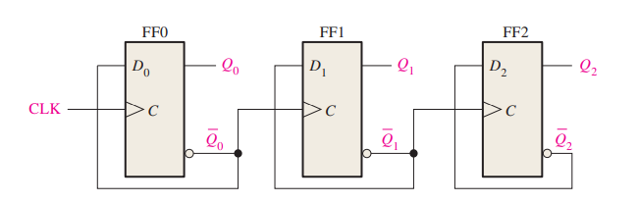
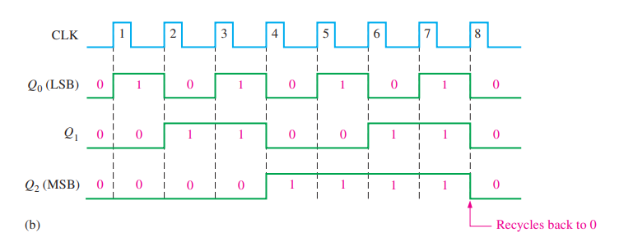
A 3-Bit Asynchronous Binary Counter

Slide 8
Propagation Delay
Asynchronous counters are commonly referred to as ripple counters for the following reason:
The effect of the input clock pulse is first “felt” by FF0. This effect cannot get to FF1 immediately because of the propagation delay through FF0.
Then there is the propagation delay through FF1 before FF2 can be triggered. Thus, the effect of an input clock pulse “ripples” through the counter, taking some time, due to propagation delays, to reach the last flip-flop.

Slide 9
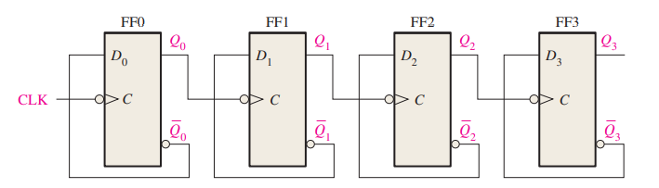
EXAMPLE
A 4-bit asynchronous binary counter is shown in Figure 9–8(a). Each D flip-flop is negative edge-triggered and has a propagation delay for 10 nanoseconds (ns).
Determine the total propagation delay time from the triggering edge of a clock pulse until a corresponding change can occur in the state of Q3. Also determine the maximum clock frequency at which the counter can be operated.

Slide 10


Solution
For the total delay time, the effect of CLK8 or CLK16 must propagate through four flip-flops before Q3 changes, so
The maximum clock frequency is
The counter should be operated below this frequency to avoid problems due to the propagation delay.

Slide 11

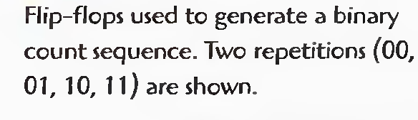
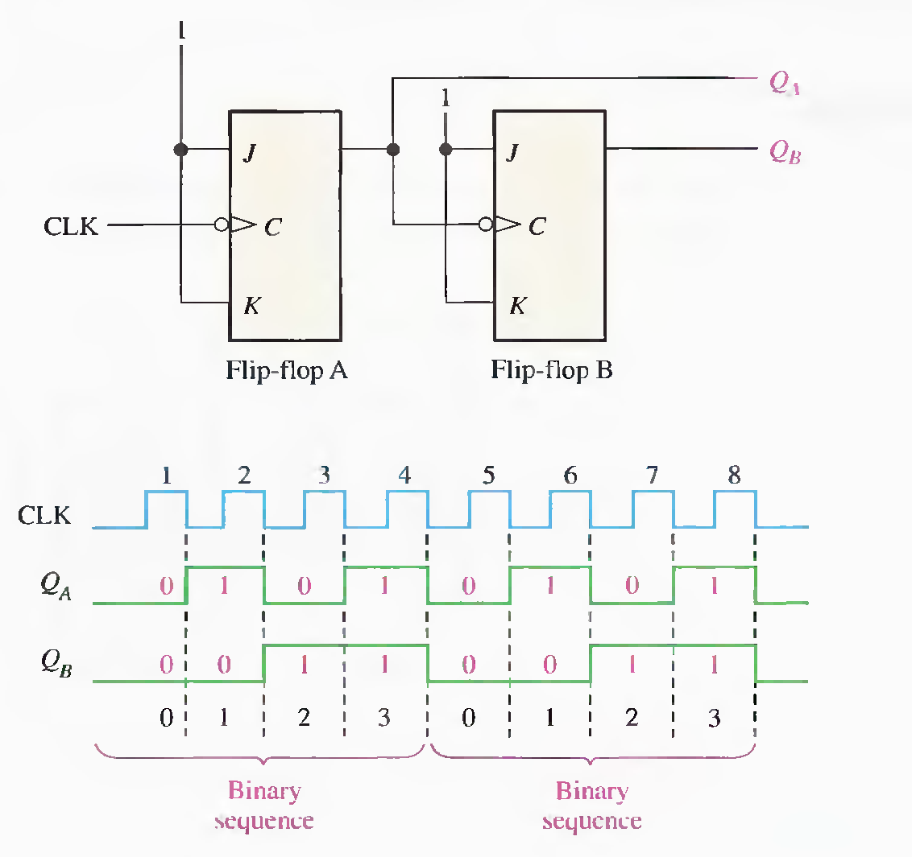

Slide 12
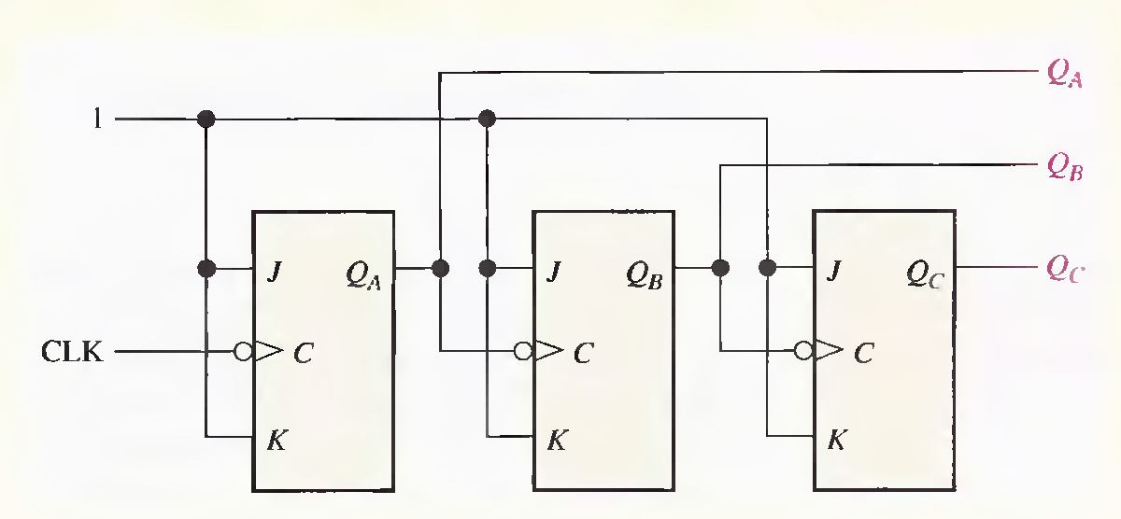
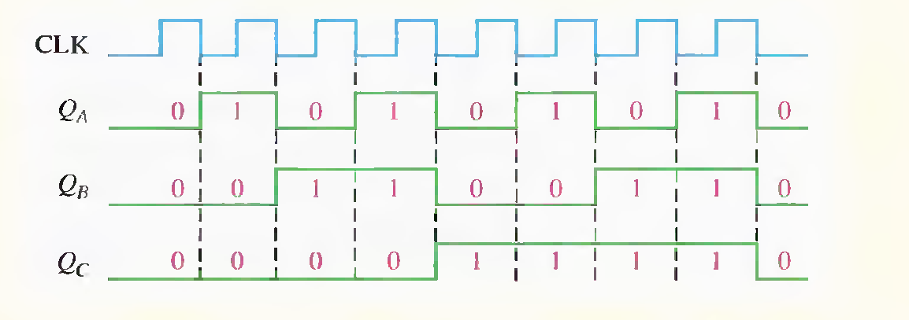

Slide 13
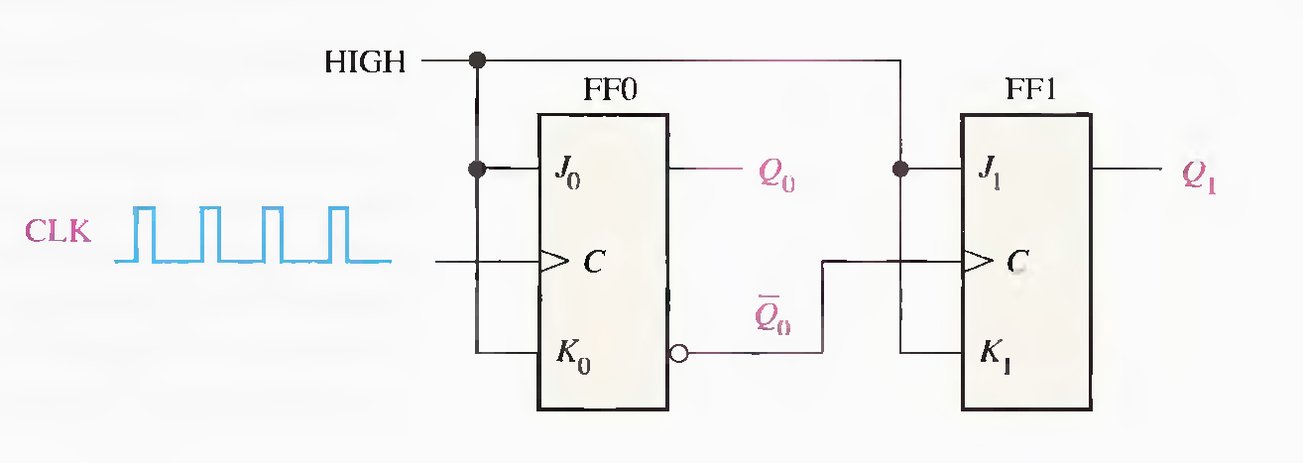
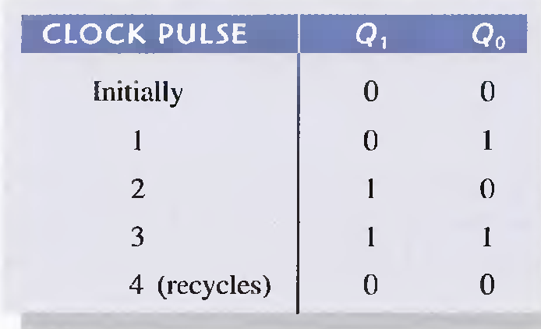
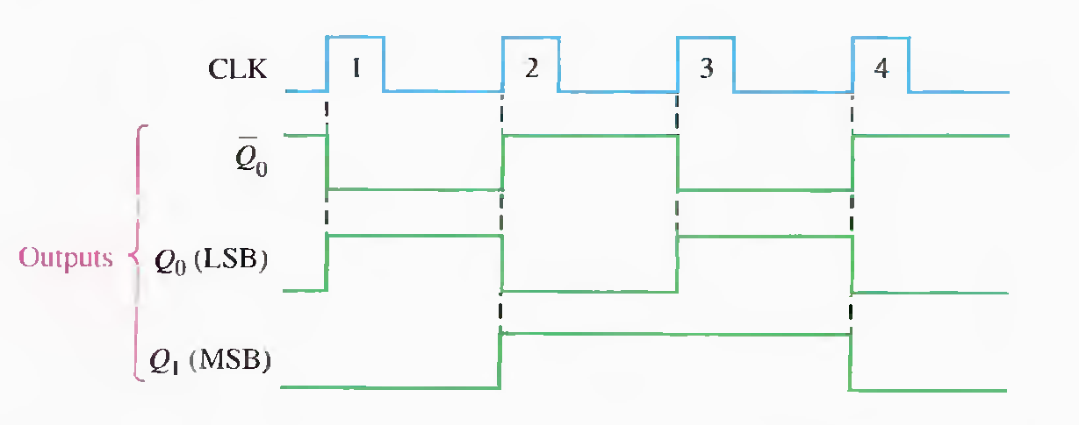

Slide 14
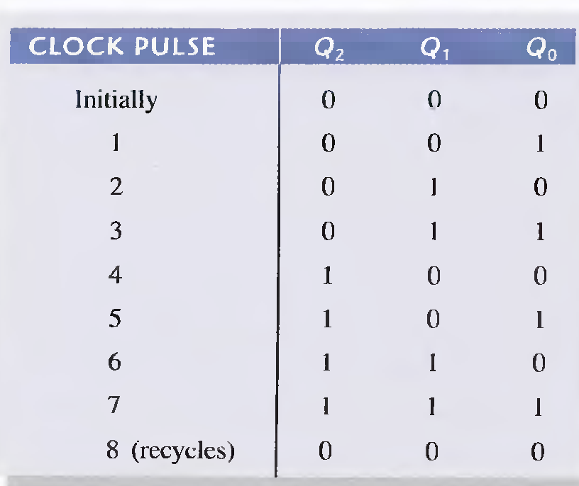
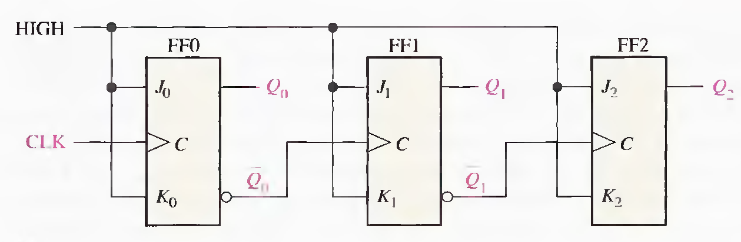
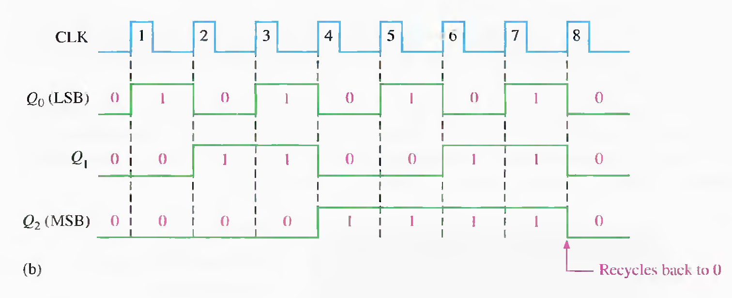

Slide 15
Synchronous Counters
A synchronous counter is one in which all the flip-flops in the counter are clocked at the same time by a common clock pulse.
J-K flip-flops are used to illustrate most synchronous counters.
D flip-flops can also be used but generally require more logic because of having no direct toggle or no-change states

Slide 16
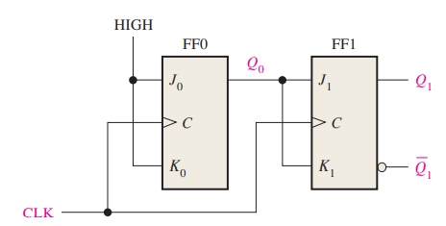
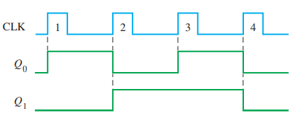
A 2-Bit Synchronous Binary Counter
(RESET INITIALLY)

Slide 17
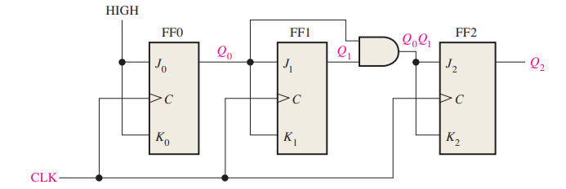
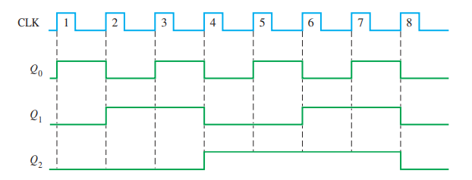
A 3-Bit Synchronous Binary Counter

Slide 18
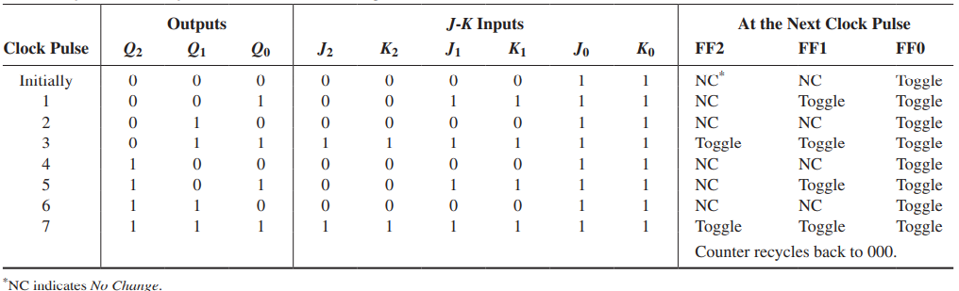
A 3-Bit Synchronous Binary Counter

Slide 19
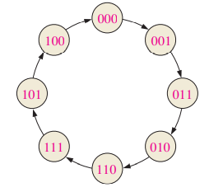
Design of Synchronous Counters (Gray Code Example)
Step 1: State Diagram
A state diagram shows the progression of states through which the counter advances when it is clocked.

Slide 20
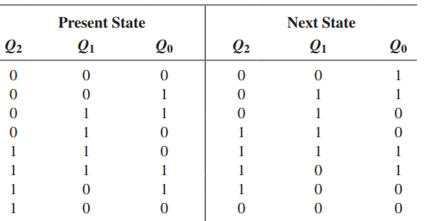
Step 2: Next-State Table
Once the sequential circuit is defined by a state diagram, the second step is to derive a next-state table, which lists each state of the counter (present state) along with the corresponding next state.
The next state is the state that the counter goes to from its present state upon application of a clock pulse.

Slide 21
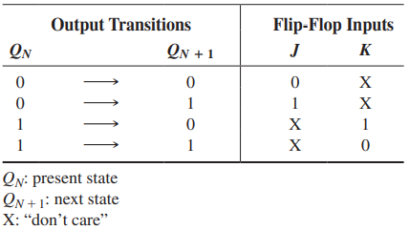
Step 3: Flip-Flop Transition Table
All possible output transitions are listed by showing the Q output of the flip-flop going from present states to next states. QN is the present state of the flip-flop (before a clock pulse) and QN + 1 is the next state (after a clock pulse). For each output transition, the J and K inputs that will cause the transition to occur are listed. An X indicates a “don’t care” (the input can be either a 1 or a 0).

Slide 22
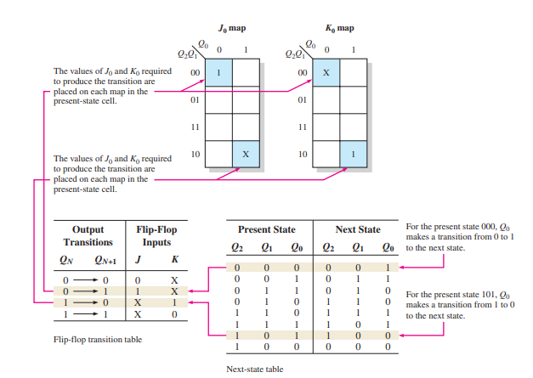
Step 4: Karnaugh Maps
In this design procedure, each cell in a Karnaugh map represents one of the present states in the counter sequence

Slide 23
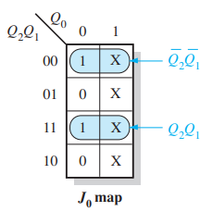
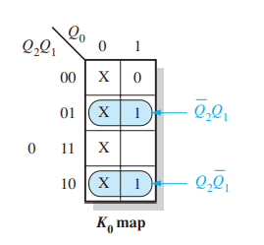
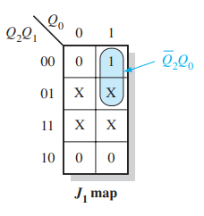
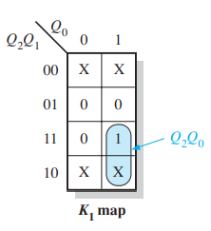
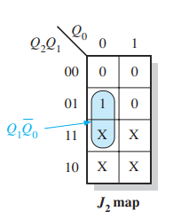
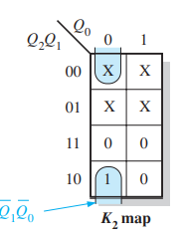

Slide 24
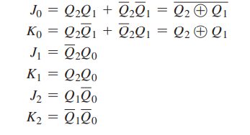
Step 5: Logic Expressions for Flip-Flop Inputs

Slide 25
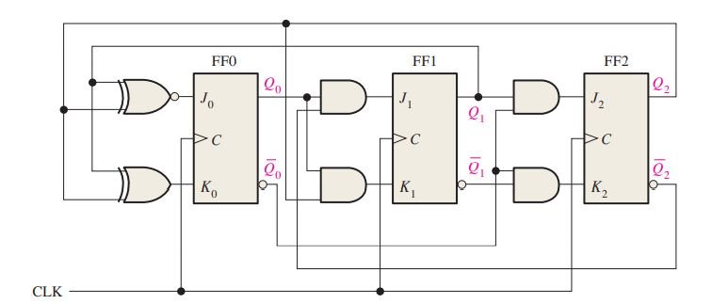
Step 6: Counter Implementation

Slide 26
Counter design using D-Flip Flop.
Example done in class.

